Slide 1
CS401 Lab 4/6/20
These slides will be available online:
https://github.com/kc13/CS401PF
Agenda for today:
Remember to submit lab to kmc51@pitt.edu
Car Dealer App, part II
Partial credit will be given for partially complete assignments
Comments on the next lab assignment
Bike Display (posted early this AM)

Slide 2
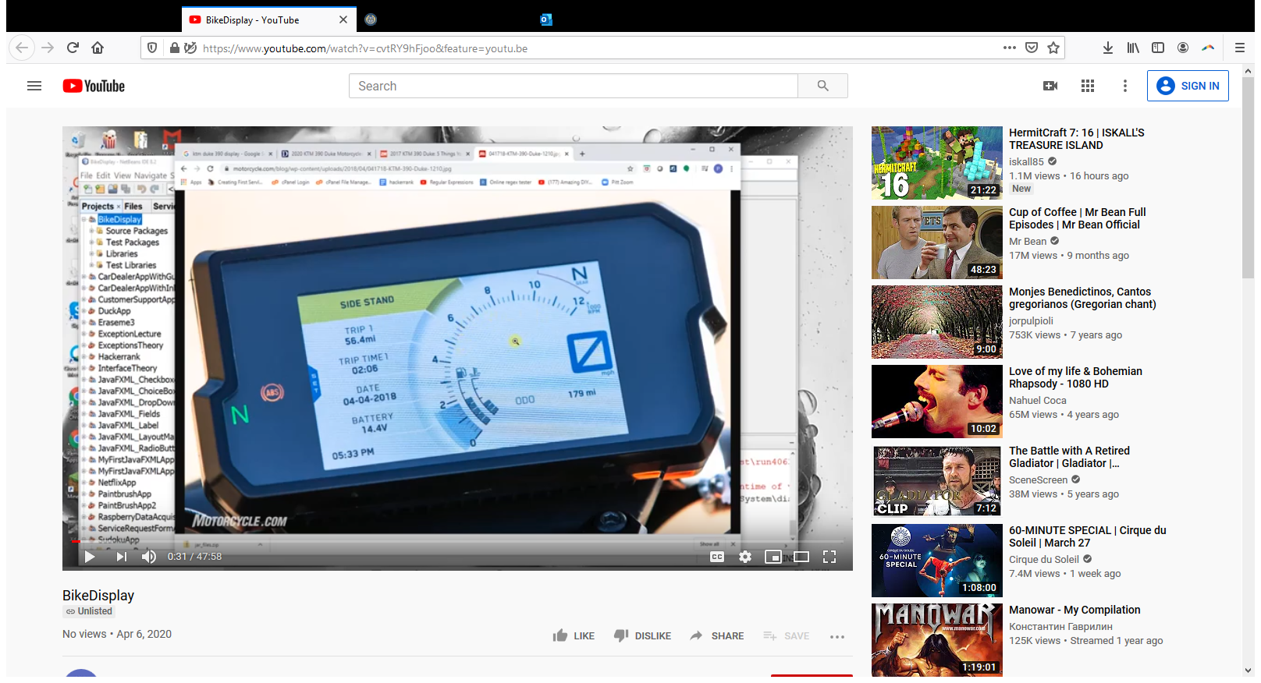
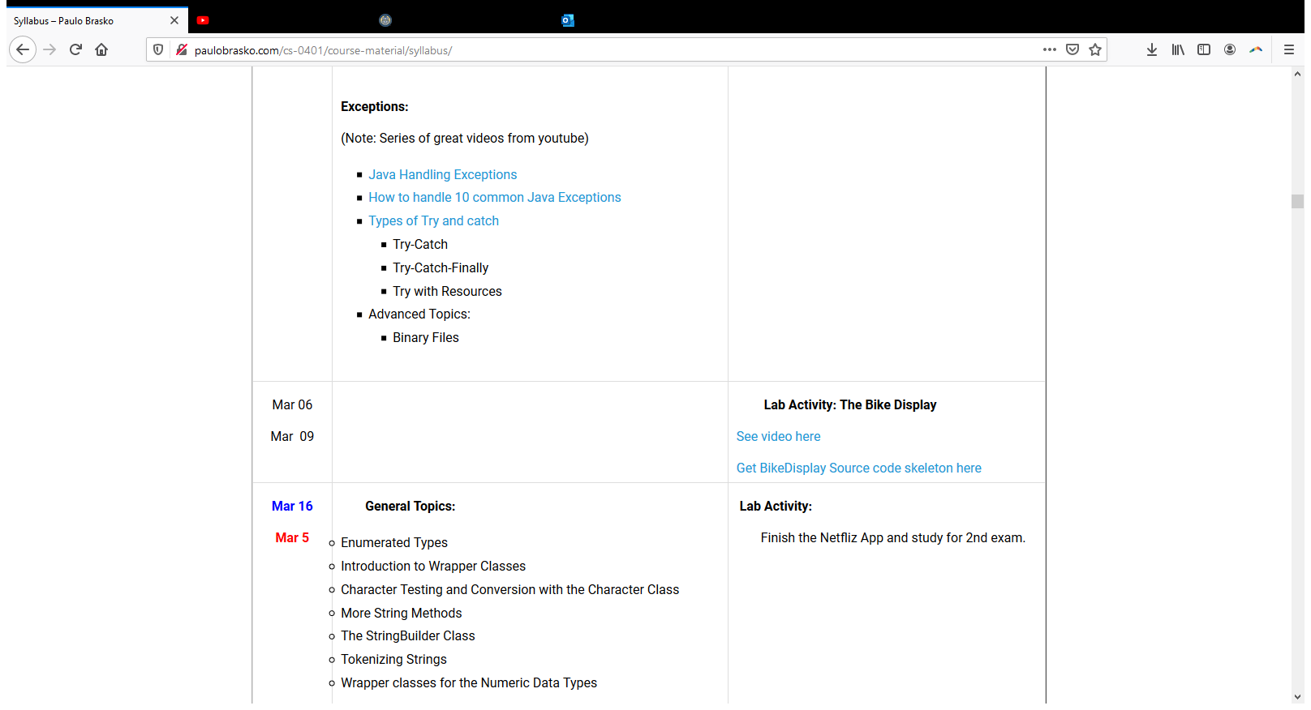
Assignment: BikeDisplay
You are to understand this application as receiving information from the sensors of a motorcycle. You will run a simulation of this.
As before, there is skeleton code available to you on the webite.

Slide 3
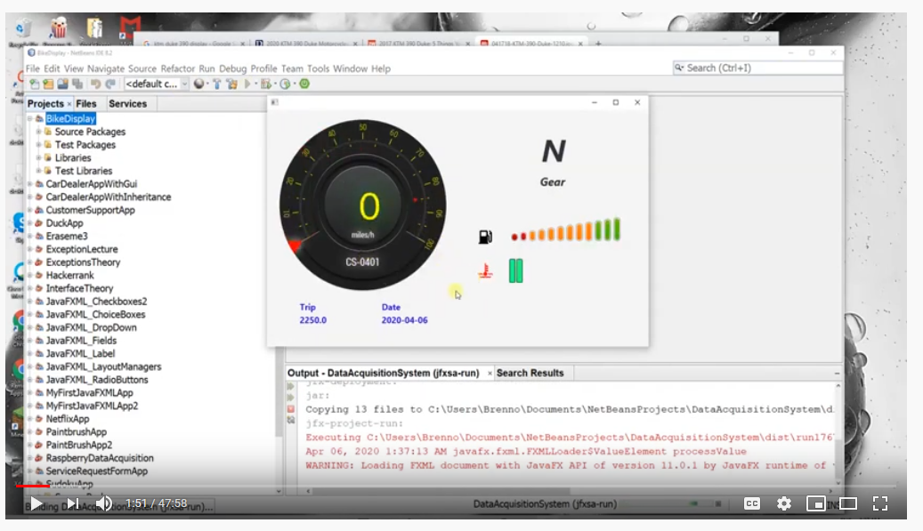
Assignment: BikeDisplay
1:51 shows simulation and approximately how it should look.
Fuel gauge, temperature indicator, etc…

Slide 4
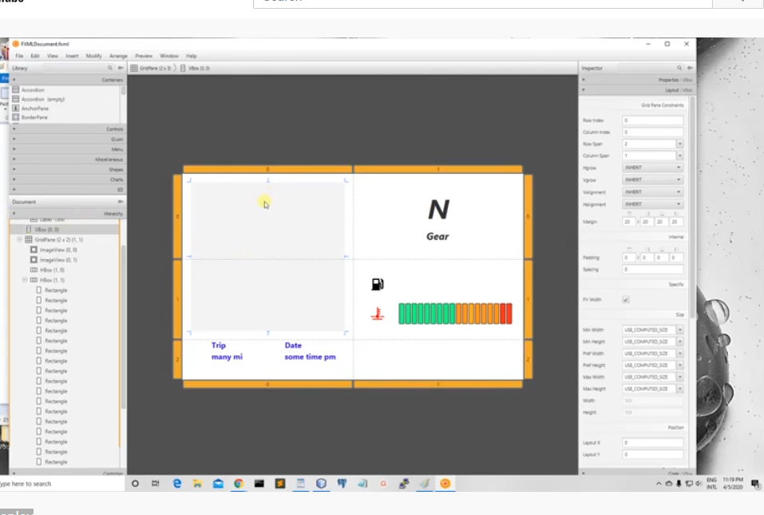
Assignment: BikeDisplay (3:42)
Talks about the method he chose to create this (grids/boxes/etc)…Some of this was imported from an outside source.
Describes giving a label to the temperature gauge so that later he can make reference to it in his code (for disabling it when relevant).

Slide 5
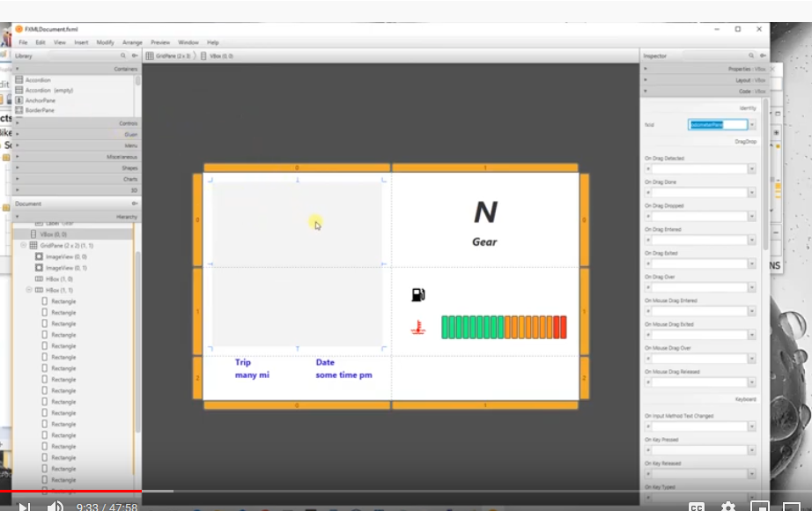
Assignment: BikeDisplay
9:33 starts talking about odometer pane (which will be put where the grey vertical box is). Mentions that he cannot create the gauge he needs there in SceneBuilder – will need to go to the code.
Describes how to get the children of the vertical box, and then create the gauge (next slide).

Slide 6
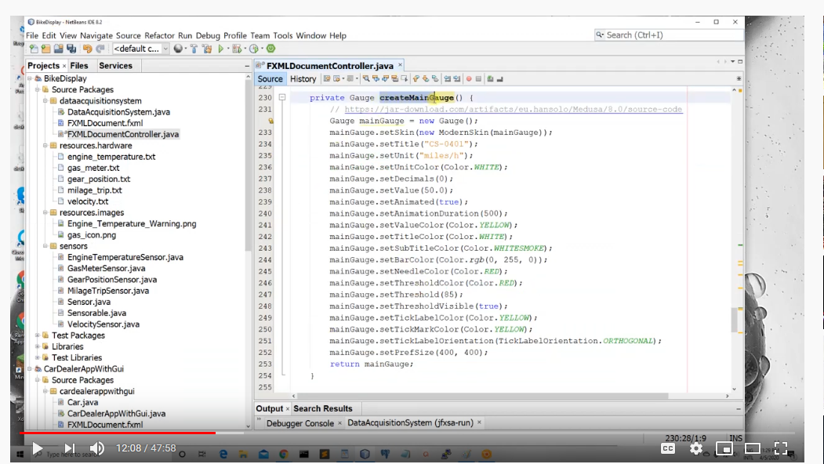
Assignment: BikeDisplay (about 12:23)
Method for creating new gauge. Note this is in the skeleton code.

Slide 7
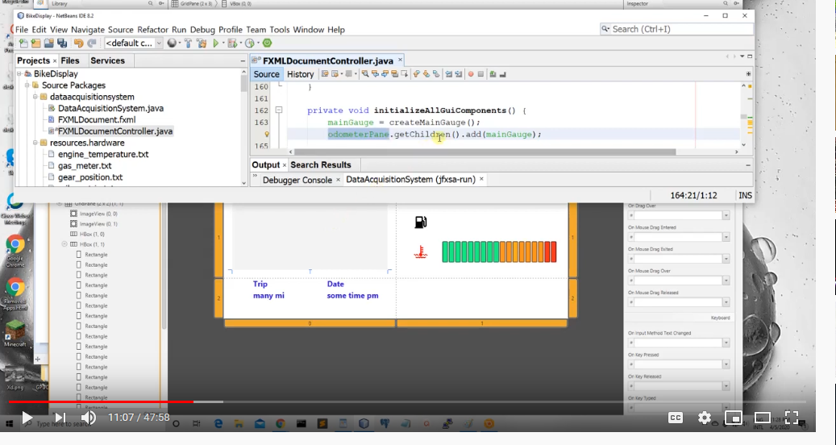
Assignment: BikeDisplay
This will be a general method for adding new components that cannot be added in SceneBuilder.

Slide 8
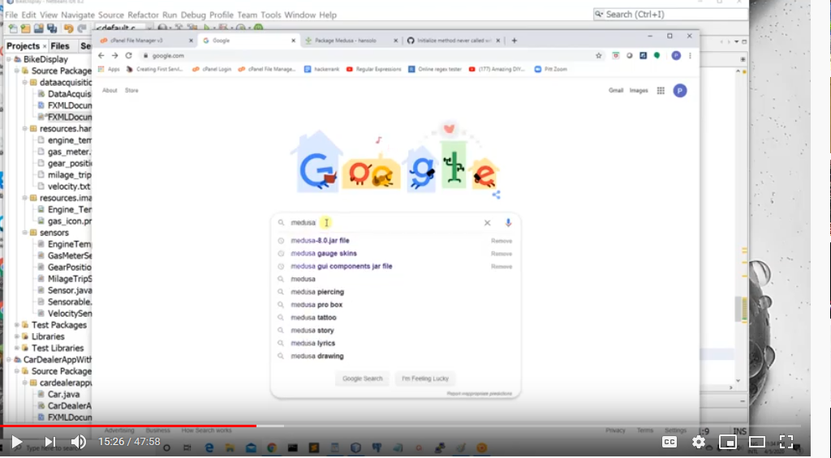
Assignment: BikeDisplay (about 15:17)
We need to import a jar file so that we can make use of the outside package. You want to get Medusa version 8 without dependencies.
Remember where you save the downloaded file so you can add the path to Netbeans.

Slide 9
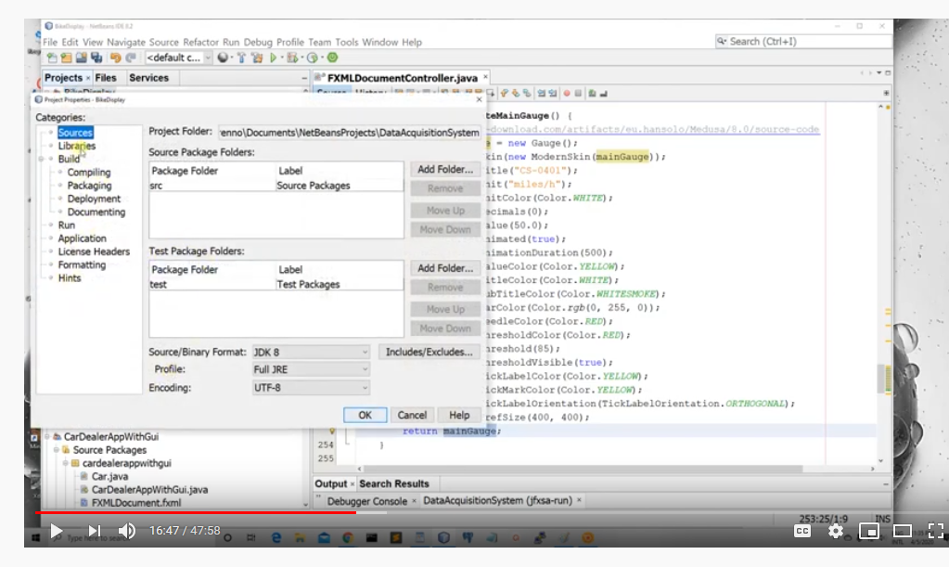
Assignment: BikeDisplay (16:47)
You’ll right click your Project name and then go to Properties.
The instructions describes how to connect Medusa to Netbeans.
Also at 19:00 refers to a YouTube video that describes how to work with the gauges.

Slide 10
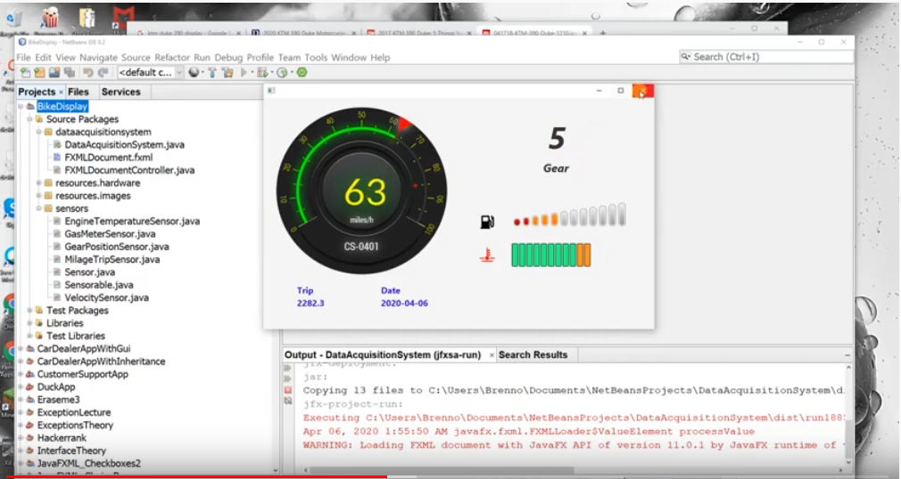
Assignment: BikeDisplay (19:55)
Begins talking about the sensors.

Slide 11
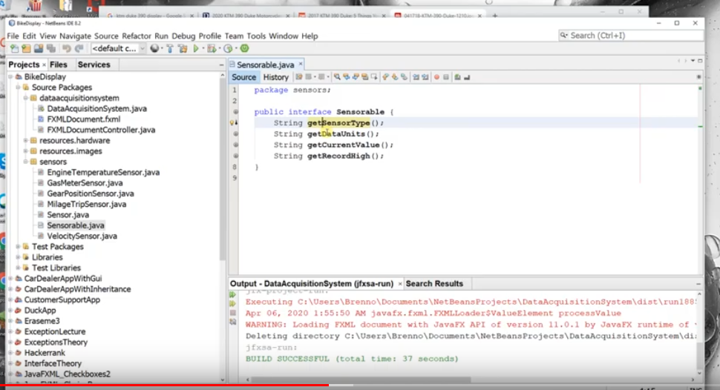
Assignment: BikeDisplay (21:41)
Creates a Sensorable interface.
You can think of an interface as being like a contract with the user. If a new class claims that it implements an interface, then that means that it guarantees that it will implement the methods described here.

Slide 12
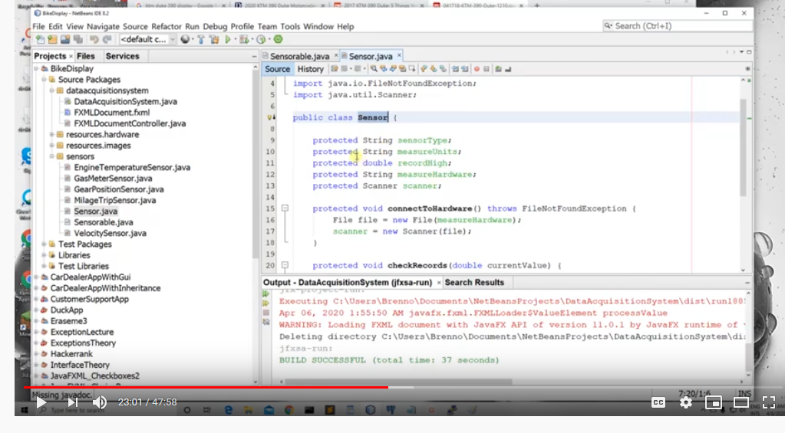
Assignment: Starts describing the Sensor superclass (23:01)
In the provided code see filepath: BikeDisplaySkeleton\DataAcquisitionSystem\src\sensors
However, the code isn’t in that file; you have to fill it in based on what is provided in the video.

Slide 13
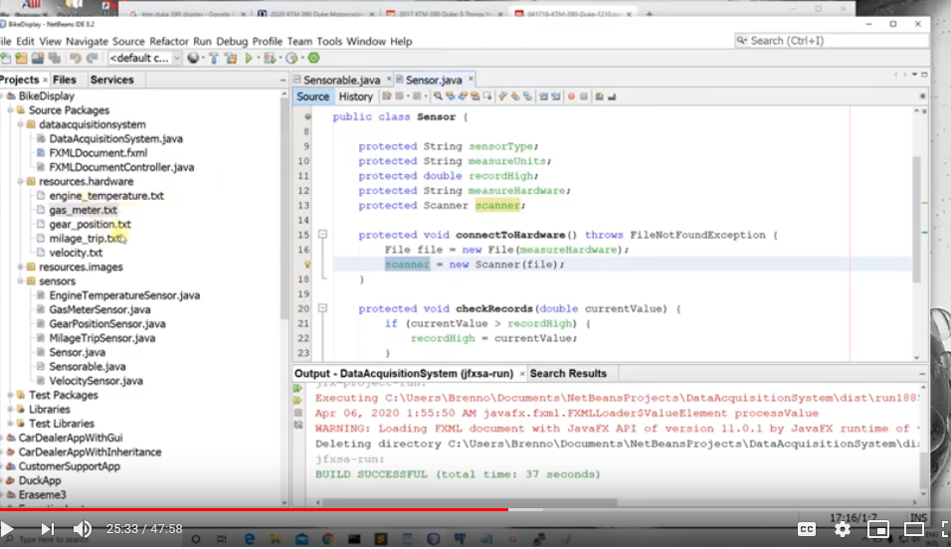
Assignment: Sensor information
The sensor information comes from text files, which he provides for you. See src/resources.

Slide 14
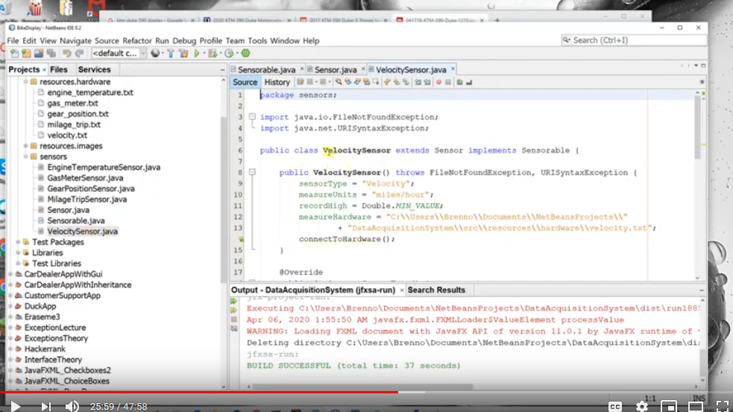
Assignment: 25:59 example of a class that extends the Sensor Class and implements the Sensorable interface.
Again, the file has been started for you, but you need to complete it.
Note you also have several other sensors that you need to create.

Slide 15
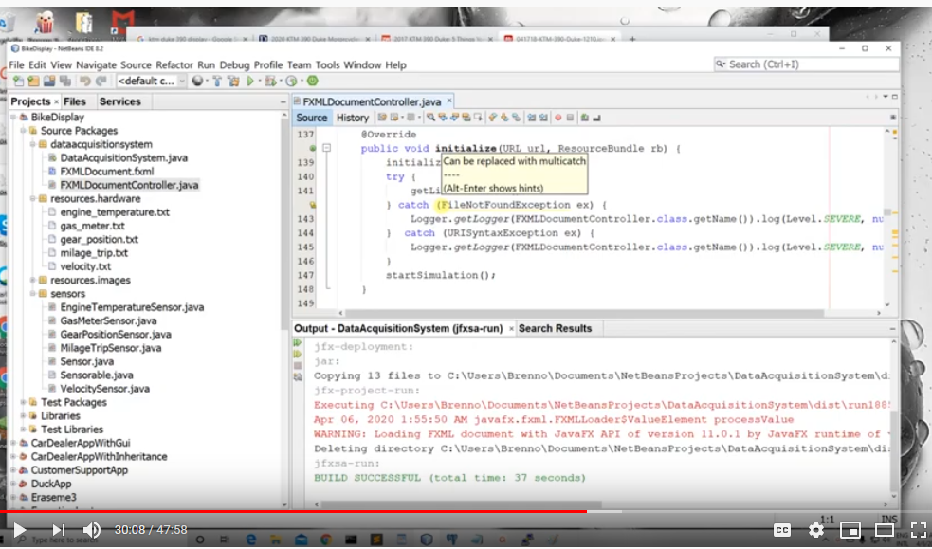
Assignment: 30:08 more detail on code implementation
Going through methods in FXMLDocumentController. You are given partial methods but need to create many of them.

Slide 16

Assignment: 37:00 running the simulation: You will need to finish the startSimulation class in such a way that it implements threading

Slide 17
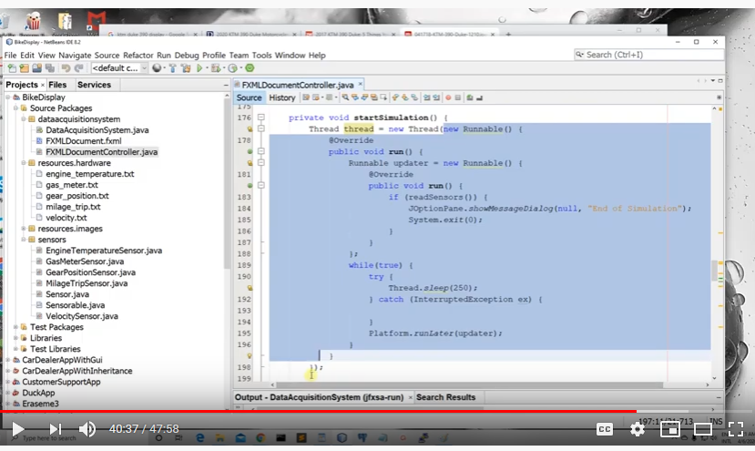
Filling in the startSimulation method (40:10)
You’ll need to follow the instructions given in the video.

Slide 18
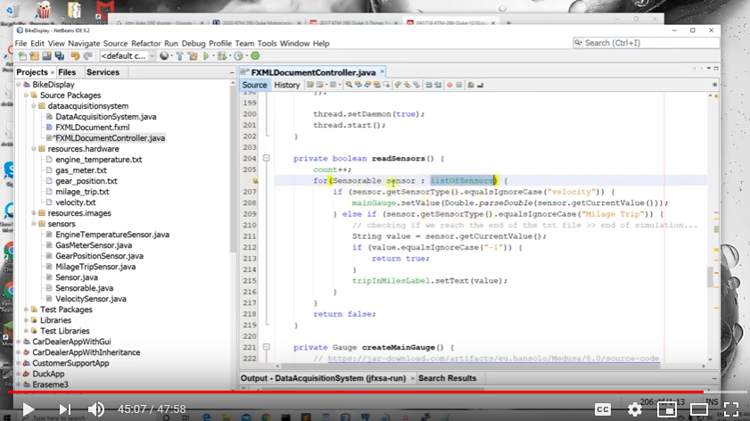
readSensors (45:00):
Some of this has been made available already in the skeleton code.
However, you have to add your own code to handle the cases for the sensors that aren’t covered here.

Slide 19
Bike Display: submission for this lab
Compress your NetBeans project (.zip or something else) and send it to kmc51@pitt.edu
Deadline: End of 4/13 lab (10:50 or 12:50 pm, depending on your section)

